Slide 1

URBAN
HOME SERVICES

Slide 2
Team Members :
Shivkumar Hande 3523
Devraj Kanki 3526
Ajinkya Kamble 3518
Aditya Karampuri 3527

Slide 3
Introduction
"Welcome to our urban home services website project, where convenience meets quality in the heart of city living. Our mission is to simplify your urban lifestyle by offering a comprehensive range of home services at your fingertips. From plumbing and electrical repairs to home cleaning and maintenance, Join us on this journey to elevate your urban living experience."

Slide 4
Problems:
1. Reliability: Hard to find trustworthy service providers.
2. Time-Consumption: Search process is lengthy and frustrating.
3. Limited Information: Lack detailed provider info.
4. Communication Issues: Disjointed communication leads to delays.
5. Payment Challenges: Hassles with unclear pricing and disputes.
6. Limited Service Options: Difficulty finding providers for diverse needs.

Slide 5
Features
1. Reliability:
- Verified Providers: Implement a verification process for service providers to ensure reliability.
- Customer Feedback: Allow users to review service providers to build trust.
2. Time-Consumption:
- Advanced Search Filters: Enable users to quickly narrow down options based on location, services offered, ratings, etc.
- Instant Booking: Provide a streamlined booking process with real-time availability.
3. Limited Information:
- Detailed Provider Profiles: Include comprehensive information about each service provider, experience, and customer feedback.

Slide 6
4. Communication Issues:
- In-App Messaging: Offer a built-in messaging system to facilitate communication between users and providers.
5. Payment Challenges:
- Transparent Pricing: Clearly display service costs upfront and provide detailed breakdowns.
6. Limited Service Options:
- Diverse Service Categories: Expand the range of services offered to a wider variety of home maintenance needs.

Slide 7
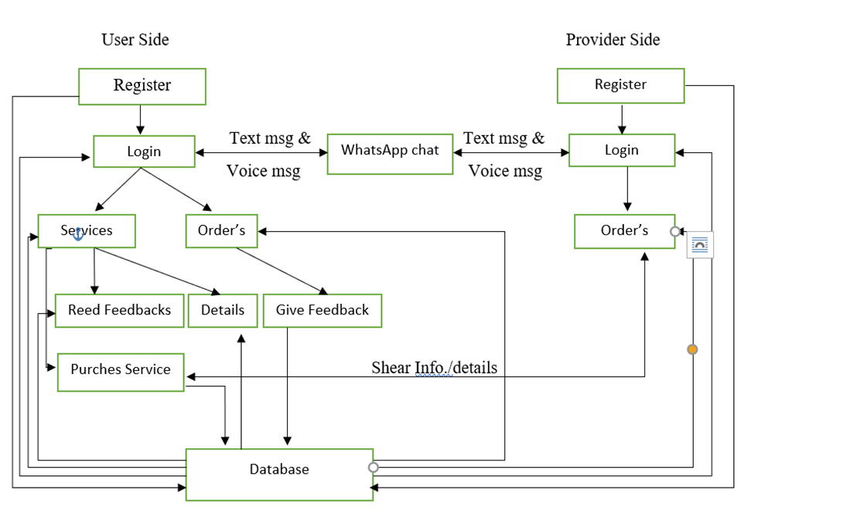
Project Working Flow

Slide 8

</>

Slide 9
Thank
You !
@UrbanHomeServices

